Slide 1
Proviso with Pseudowords: A Pilot Study
2020 Nov 16
Link: https://spellout.net/ibexexps/sherrychen/proviso2020_sur/experiment.html

Slide 2
Participants
22 participants recruited from Twitter & Facebook
Filtering based on the control item “John is a glorp and he has a dord”
“…John doesn’t have a dord”:
14 got 80+ (11 got amost 100)
5 got 60+
3 got 0-25
“…John is a glorp”: 20 got 0, 1 got 5, one got 12
Instruction: example said “very surprised” instead of “totally”!!!
Due to noise (handler sensitivity & some people not so strict), I’m only excluding those who responded below 60 for “…John doesn’t have a dord”.
This leaves us with 19 participants.

Slide 3
“Could be either way” & “surprised”?
There seems to be different understandings of how “surprised” people are when things “could go either way”:
Some (like us) think it’s 50 (treating it like probability).
BUT many actually think it’s 0, because there’s no prior contradictory information and we are just learning something new, so nothing to be really surprised about; for 50, you’ll be “somewhat surprised”, since 100 is “totally surprised”
Comments: “Took me a while to catch on to *if* alien is an xyz she will xxx but on reflection there should be no surprise that alien is type A or not type A. It's all about assumptions”
Questions:
Does it have to do with 0 being the initial state of the handler?
The example we gave in the instruction?
Will a different wording change it, e.g. surprised vs. unexpected?

Slide 4
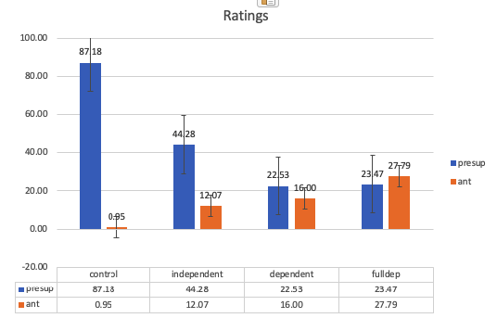

Ratings: Control
“John doesn’t have a dord” is close to 90, because it was a contradiction
“John is a glorp” is close to 0, because it was consistent with the prior informaiton

Slide 5

Ratings: Independent
“John doesn’t have a dord” is around 44; people are somewhat surprised, but obviously not as surprised as seeing a contradiction;
“John is a glorp” is around 12

Slide 6
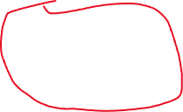
Ratings: Dependent & FullDep
Dependent:
“John doesn’t have a dord” is 22.5;
“John is a glorp” is 16
FullDep
“John doesn’t have a dord” is 23.5
“John is a glorp” is 28
“John doesn’t have a dord”:
Quite similar
Both lower than Independent

Slide 7


Differences between ratings for presup
People seem to be more surprised at “John doesn’t have a dord” in Independent: might suggest that they strengthened to a non-conditional inference “John has a dord” in Independent, at least more so than they did in Dependent & FullDep
Not a huge numerical difference here (around 22), but we only have 19 observations. Need more power to test for statistical significance!

Slide 8

Differences between ratings for Ant
Tiny difference between Ant in Independent & Dependent: people are not surprised when they learn “John is a glorp”
Ant in FullDep: ???
Driven by some outliers: 1 weird dude chose 80+, 2 chose 95+
This is not the same as Independent Presup, where you can observe a genuine different distribution!

Slide 9
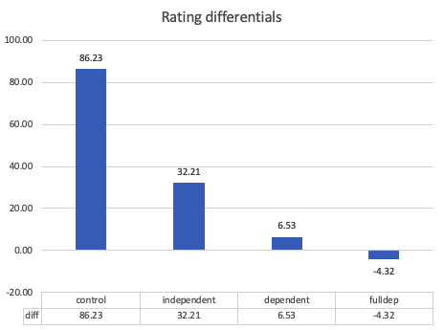
Rating differentials
Differentials of presup-ant is larger in Independent than Dependent & FullDep
Differentials of presup-ant are similar in Dependent and FullDep
But negative in FullDep, because of the weirdly high-ish ratings for Ant there……
Maybe we don’t have to worry about it so seriously because it’s driven by outliers & we have little data
Item filtering? e.g. Ant has to be < 50 or something

